Slide 1
Agile PRESENTATION
Jax Francis

Slide 2




MEET OUR Scrum TEAM
TAKUMA HAYASHI
MIRJAM NILSSON
FLORA BERGGREN
RAJESH SANTOSHI
Product Owner
Which are also stakeholders. Their main role is to manage the product development process. They work closely with the team to identify user needs and ensure that the customer's expectations of the product are met. After gathering feature requests, schedule releases, and coordinate sprints.
Scrum Master
The Scrum Master is facilitator and coach. This role consist of helping the scrum team organize, understand, and apply scrum theory and practices. They also help the scrum team work more effectively by removing obstacles that are in the way of the team meeting their goals.
Tester and/or Testers
The testers execute and log the tests. They evaluate the results and document problems found. Also well gathering performance metrics they tend to monitor the testing and test environment using tools for task.
Developer and/or Developers
They are also known as technology professionals. Their role is to build and create software, websites, applications and other systems. Developers require writing code knowledge and having to ability to debug source code for applications and software effectively.

Slide 3
AGENDA
Explain the various roles on a Scrum-agile Team by identifying each role and describing its importance.
Explain how the various phases of the SDLC work in an agile approach. Be sure to identify each phase and describe its importance.
Describe how the process would have been different with a waterfall development approach rather than the agile approach you used. For instance, you might discuss how a particular problem in development would have proceeded differently.
Explain what factors you would consider when choosing a waterfall approach or an agile approach, using your course experience to back up your explanation.

Slide 4
Agile sdlc model
The Agile Software development lifecycle model collaboration of incremental process models. Which main focus is to provide rapid delivery of working software product, based on adaptability for customer satisfaction. The product is broken down into small incremental builds when using agile methods. Iterations is what the builds are provided into, and they last for about one to three weeks. The seven iteration on the next slide are the functions of a team working simultaneously in the agile methology.

Slide 5
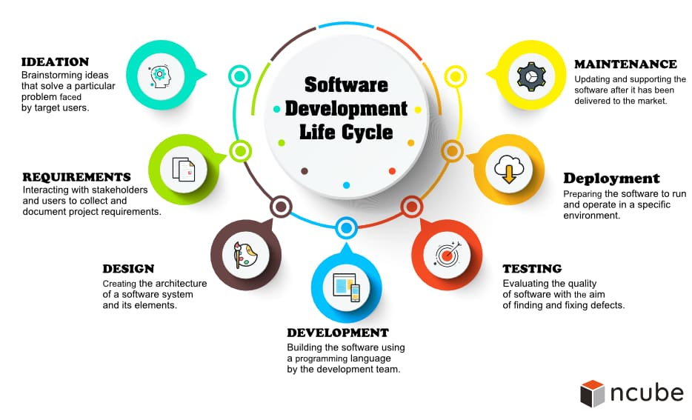
Software Development life cycle

Slide 6
Waterfall Model
The waterfall was the first SDLC model used in Software Engineering widely ensuring project success. The waterfall model steps are just what the name indicate, it is processed in order phases after phase in a linear sequential flow. This means that the next phase process can only begin by completing the previous phase is complete. Phases do not overlap in the waterfall model.

Slide 7
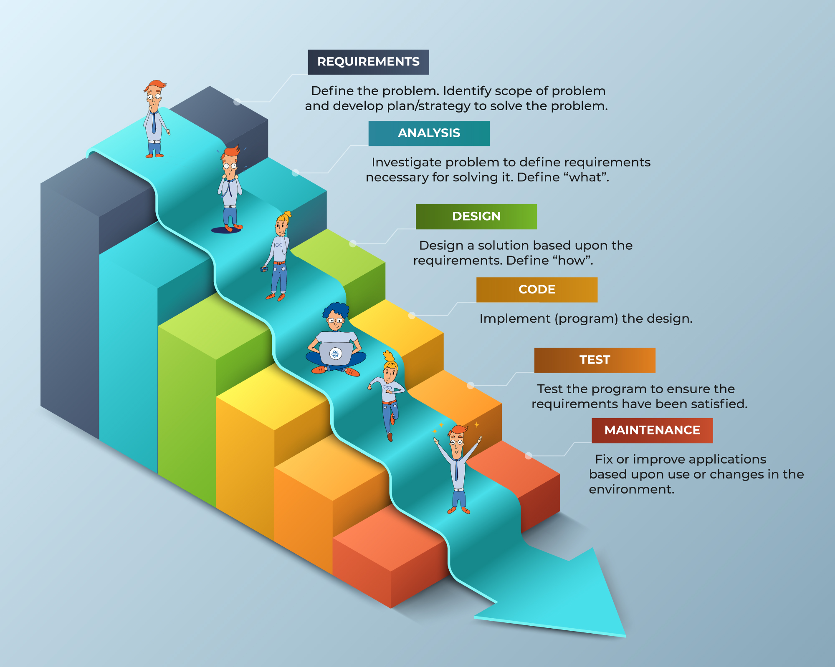
Waterfall Model

Slide 8
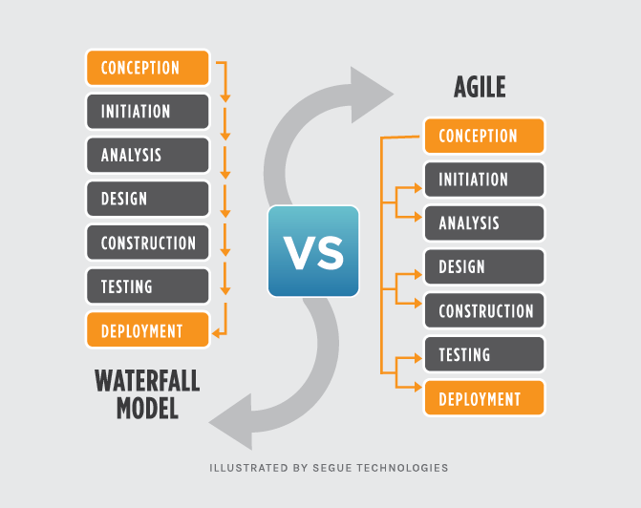
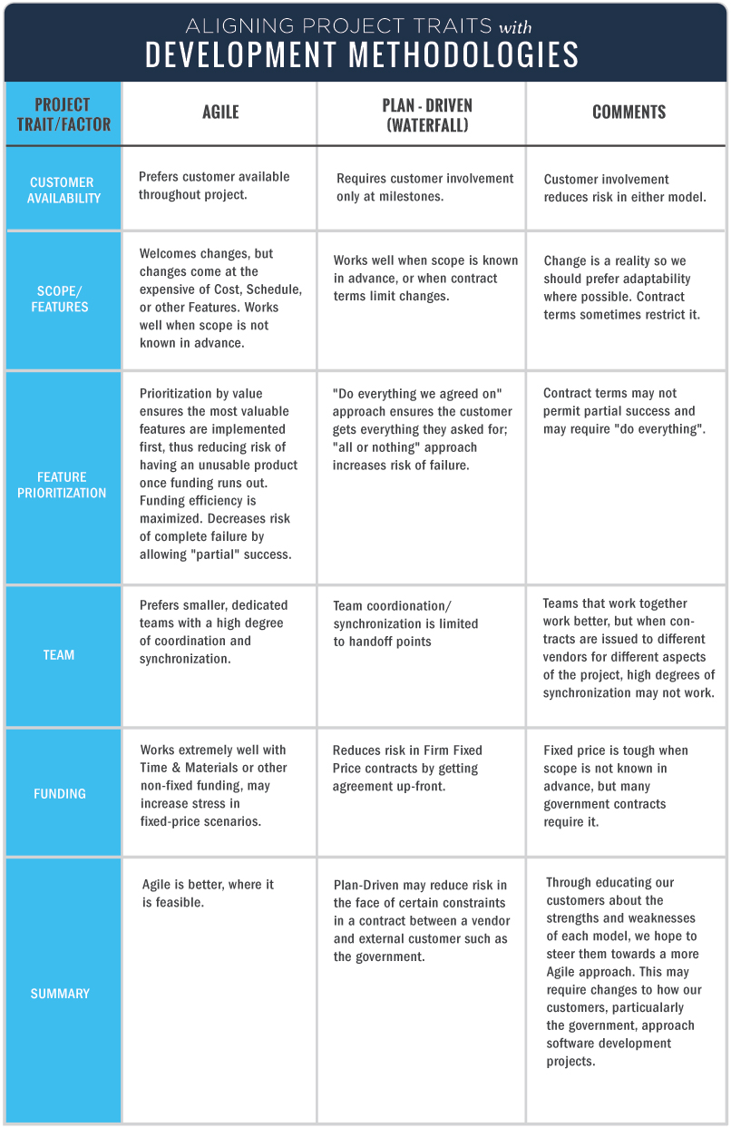
Agile and Waterfall Models
When using waterfall changes in mid process is not recommend due to the negative effect on the flow. If so, this could cause loss of time and money in the process.
The agile model is great for back tracking. For example, in the SNHU travel project the stakeholder want to change the type of vacation that would be developed towards the end of the project but with the agile model we were about met their needs and expectations.
For additional understanding, the chart to the right is a helpful resolution explaining both models.

Slide 9
Summary
In Summary, projects like SNHU Travel's application that involves the stakeholder and this dynamic, are well-suited for the Scrum-agile approach. It fostered collaboration, adaptability, and a continuous improvement that was crucially needed for the success of the SNHU Travel's application project.

Slide 10
THANKs Too
REFERENCES
https://www.tutorialspoint.com/sdlc/sdlc_waterfall_model.htm
https://www.tpgi.com/accessible-sdlc/
https://kruschecompany.com/waterfall-software-development-methodology/
https://www.tutorialspoint.com/sdlc/sdlc_waterfall_model.htm

